Slide 1
Basic of Python
Girish S Kumar

Slide 2
Variables in python
Variables are container of data
Python Variables can store , number, characters, strings, descriptors etc in variables
Unlike is C/C++ there are not sperate data types for variable in python. Python does not distinguish between Integer character variables
There is not need to declare variable prior to usage
A variable is created at the time of first initialization
In the previous example when we say
X = 10
Y = 20
The moment when interpreter execute the statement x = 10 a integer variable is created. Same with y too.

Slide 3
Rules for naming Variable
In python the rules of naming identifiers are applies to variables too
• The first character of the identifier must be a letter of the alphabet (uppercase ASCII or lowercase ASCII or Unicode character) or an underscore ( _ ).
• The rest of the identifier name can consist of letters (uppercase ASCII or lowercase ASCII or Unicode character), underscores ( _ ) or digits (0-9).
Identifier names are case-sensitive. For example, myname and myName are not the same. Note the lowercase n in the former and the uppercase N in the latter.

Slide 4
Concept of Physical and Logical lines
A physical line is what you see when you write the program.
A logical line is what Python sees as a single statement.
Python implicitly assumes that each physical line corresponds to a logical line.
Length = 10
print Length
Logical Line and Physical Line are the same
Length = 10 ; print Length
Two Logical Line in a Physical Line
Separate by a semi colon

Slide 5
A logical line can be broken into two physical lines when it does not fit into one line it is done with \ character
Example
myStr = 'This is actually a string. \
The string is continued in the next line.'
print s
Output of the this program will be:
This is actually a string. The string is continued in the next line.

Slide 6
Indentation in Python
Indentation is a very IMPORTANT CONCEPT IN PYTHON
White spaces which are inserted at the beginning of a logical line is called indentation. White spaces can be blank space or tab.
print “Hello World” --→ Has not indentation
print “Hello World” -→ has two white spaces inserted hence it is indentated
Python uses these indentation to identify blocks of statements.

Slide 7
To give you an example of how indentation is important.
print “Hello World”
print “Hello World”
Will print Hello World twice in the screen
print “Hello World”
print “Hello World”
pi@arjuna:~ $ !p
python indent.py
File "indent.py", line 2
print "Hello world"
^
IndentationError: unexpected indent
pi@arjuna:~ $
Indentation should be used only where ever it is needed

Slide 8
Indentation should be used only where ever it is needed. There are many places we have to use indentation (must). So indentation is very critical aspect in Python
This will be discussed in the subsequent section

Slide 9
Input output operations with console in python

Slide 10
Output : Printing on Console
age = 10
print ‘My age is’, age
print ‘I am’, age , ‘years old’
pi@arjuna:~ $ !p
python indent.py
My age is 10
I am 10 years old
pi@arjuna:~ $
s = ‘’’ This is a multi-line string.
This is the second line.’’’!
print s
pi@arjuna:~ $ python try.py
This is a multi-line string.
This is the second line.
pi@arjuna:~ $

Slide 11
Input : Reading on Console
length= raw_input('Enter an integer : ')
print length
pi@arjuna:~ $ python input.py
Enter an integer : 45
45
pi@arjuna:~ $
In the above example raw_input() return the entered value as character string and not as a number, hence we cannot do any arithmetic operation on the variable length , let us demonstrate this in the next section

Slide 12
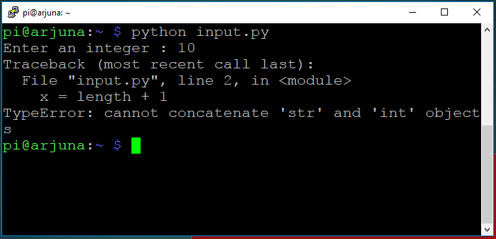
Let us make a small modification
length= raw_input('Enter an integer : ')
x = length + 1
print length
print x
we NOT are able to do arithmetic operations on the variable length

Slide 13
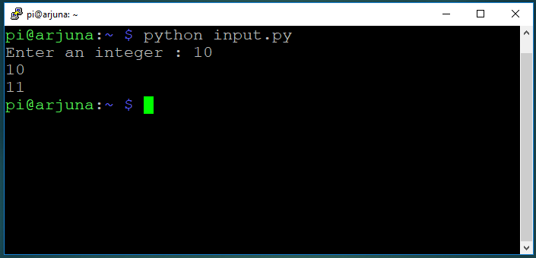
Let us make a small change to fix this issue
length= int(raw_input('Enter an integer : '))
x = length + 1
print length
print x
Now we are able to do arithmetic operations on the variable length

